Slide 1
6.S092 Lecture 1
Intro

Slide 2
Staff
Hau Lian
Natalie Huynh
Jared McKeon
Dang Pham
6.s092@mit.edu (goes to all four of us)

Slide 3
Class Details
Stellar: https://stellar.mit.edu/S/course/6/ia15/6.S092/index.html
Piazza: http://piazza.com/mit/spring2015/6s092/home
11 lectures, 3-4 assignments
You have to write your own code!
PASSING: complete and pass four assignments
Bring your laptops!

Slide 4
What we’ll do
Learn Java
Learn how to use Eclipse
Learn some programming concepts that will appear in 6.005

Slide 5
What we’re assuming
You know how to program
You’re taking 6.005 eventually

Slide 6
Resources
6.005 Elements of Software Construction site: http://stellar.mit.edu/S/course/6/fa14/6.005/
Sun Java Tutorial http://docs.oracle.com/javase/tutorial/index.html
Piazza
Google Feedback Form
Google is your friend!

Slide 7
What is Java?
1991 - 1995 Originally developed by James Gosling at Sun Microsystems (later merged into Oracle 2009 - 2010)
● Aimed to have a familiar C/C++ style notation and architecture neutrality, “Write Once, Run Anywhere”
● Became popular with the ability to run Java applets within web pages
● 2006 - 2007 Sun released Java as free and open source software (FOSS)
Used by over 9 million developers!

Slide 8
Java is compiled
You write source code that you save with a
.java extension.

Slide 9
Java Roadmap
Primitive Data Types
Data structures
Operations
Control flow

Slide 10
Types
int: Integer (1, 0, 42, -1248)
double: Real number (3.14, 1.0, -0.8)
String: Text consisting of characters (“hello”,
“MIT”)
boolean: Truth value (true or false) // note the lowercase

Slide 11
Types cont.
byte
short
char
long
float

Slide 12
Primitive Data Structures
arrays
String

Slide 13
Rules for naming
● Case sensitive
● An unlimited-length sequence of Unicode letters and digits, beginning with a letter, the dollar sign "$", or the underscore character "_"
● White space is not allowed
● Cannot use any of the 50 reserved words or
keywords (e.g. class, int, void)

Slide 14
Conventions for Naming
Variables should be meaningful
CONSTANTS in all CAPS
All other variable start with lowercase but use camelcase.
camelcaseLooksLikeThis

Slide 15
Assignment
Java is “statically-typed” so all variables must be declared before being used (otherwise you’ll throw a compile exception!)
Insufficient in Java:
lastName = “Menendez”;
Instead:
String lastName = “Arjuna”;
‘=’ is used for assignment ONLY

Slide 16
Re-assignment
This is also valid:
int todayLow = 6;
todayLow = 12;

Slide 17
Conversion
double score = 3.5;
int otherScore = score + 5; // INVALID
int simpleScore = 2;
double copy = 2; // This is fine! No data is lost.

Slide 18
Output and comments
// Double slashes denote the beginning of inline comment
/*
Slash star can also be used to comment, but this is a block comment
*/
System.out.println(“And this is getting printed to console”); // NOTE THE SEMICOLON

Slide 19
Casting
Sometimes you have to force it.
double score = 3.5;
int simpleScore = (int) score; // simpleScore = 3
...you can’t force everything.
int num = (int) “String!”;

Slide 20
Binary Operators
int x = 4;
out.println(x++); //postfix, outputs 4
out.println(++x); //prefix, outputs 6!
“Do a thing and then increment” vs. “Increment and then do a thing”

Slide 21
String concatenation
public static void main(String[] args) {
String text = "Lucky" + " numero ";
text = text + 2 + "!";
out.println(text);
}

Slide 22
Order of Operations
Assignment: =
Addition: +
Subtraction: -
Multiplication: *
Division: /
Modulo (integers only!): %

Slide 23
Conditionals
== Equal
!= Not equal
> Greater than
>= Greater than or equal to
< Less than
<= Less than or equal to

Slide 24
Control flow
What we’d like:
Do something only when X is true
Do something a certain number of times
Keep going or come back to a line of code

Slide 25
Decision-making
if (Boolean expression) {
STATEMENTS
}
if ( isValid )
if ( numFriends > 4)

Slide 26
Fancy: ternary conditional
For dynamic assignment
Type var = expression? valIfTrue : valIfFalse
int x = 5;
int y = x <= 5 ? 6: 7;
System.out.println(y); // Will print 6

Slide 27
Decision making, cont.
if( …) {
// …
} else if (...){
// …
} else {
// …
}

Slide 28
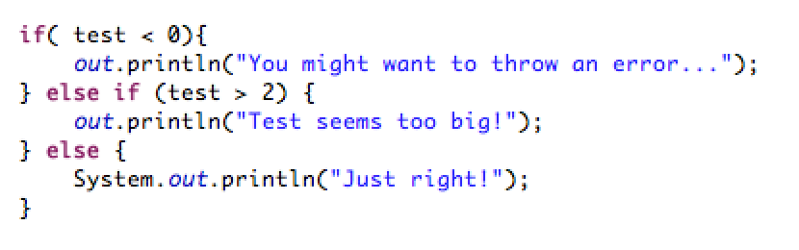
Decision making example

Slide 29
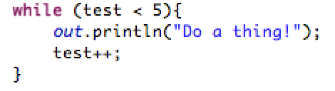
Loops #1
while loops
while( this is true) {
// do things
}

Slide 30
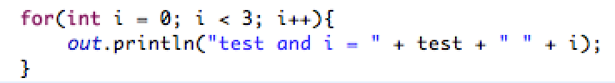
Loops #2
for loops gather the initialization term,
termination condition and increment operation
into one place
for (initialization; termination; increment) {
statements
}

Slide 31
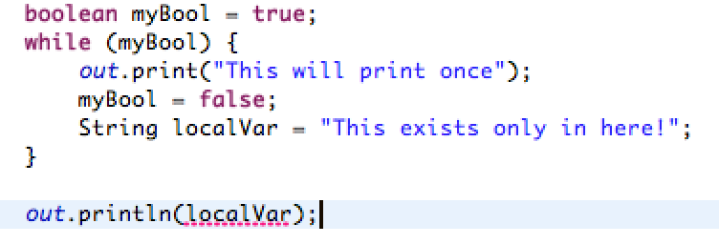
A quick word on scope

Slide 32
Arrays
A primitive data structure!
Type[] arrayName = new Type[INT_SIZE];
Arrays are of a fixed size. (Coming soon: ArrayList)
Zero-indexing

Slide 33
Arrays, cont.
int[] nums = new int[7]; // using an int
int x = 5;
int[] nums = new int[x]; // using a variable
int[] nums = new int[4*3 -2]; // using an expression
Use any way of declaration!

Slide 34
Arrays, cont.
Go ahead, initialize.
Type[] array = {/* LIST OF VALUES */};
From Assgn. 1 Test:
String[] test = {"JAVA", "MIT"};

Slide 35
Do-While
Execute a block of code at least ONCE and if condition is true goes through the loop again.

Slide 36
Let’s go to the computers!

